Slide 1

Systems Monitoring Server
Henry Zektser, Zemenu Guanche, Jorge Castro, Martha Agbugui
Jorge Castro
Notes:
Hello. This is the final presentation for the systems monitoring server project

Slide 2
Agenda
Project Charter
Problem, Solution, and Benefits
Requirements
System Design
UI, Infrastructure, Information Architecture, and Security
Jorge Castro
Notes:
In this presentation, we will cover the project charter, consisting of the problem statement, technology solution, and project benefits. We will then cover the high-level requirements for the project. Finally, we’ll review the system design, including UI mockups, infrastructure, information architecture, and the security and privacy architecture.

Slide 3
Project Charter – Problem Statement
Inefficient system monitoring, disjointed incident management, and inadequate communication during downtime undermine the operational resilience and customer satisfaction.
Jorge Castro
Notes:
This project is the result of a common problem for IT organizations. Inefficient system monitoring, disjointed incident management, and inadequate communication during downtime undermine the operational resilience and customer satisfaction.

Slide 4
Project Charter – Technology Solution
Monitoring, Alerting, and Visibility
Multiple Monitor Types (TCP, HTTP/S, Ping)
Email Alerting
Server History
Status Page
Martha Agbugui
Notes:
The proposed solution is a comprehensive systems monitoring server that combines monitoring, alerting, and user visibility in a unified platform. Specifically, the system will allow users to define servers to monitor by providing an IP or an http(s) URL, and a list of users’ email addresses to alert in the event of issues. The system will continually monitor all IPs via ping and URLs via curl, and email alerts in the event of invalid status codes. A status page, showing a list of monitored servers, their current pass/fail state, and any recent issues will also be provided.

Slide 5
Project Charter – Benefits
Enables alerts of server downtime to be received within 5 minutes of an adverse event.
Enables a 30-day historical view of all events.
Enables a single-page view of all monitored systems and their current status.
Martha Agbugui
Notes:
Implementation of this project will enable alerting of server outages to be received within 5 minutes of an issue. It will further provide a historical view of all past issues with a given server or system to aid support staff in incident response and remediation. This project will also enable organizations to publish a status page to end-users, allowing them to see the current state of all systems and stay apprised of any ongoing issues.

Slide 6
Requirements
Status Page
Server History
Server Management
Alert Management
Server Monitoring
Martha Agbugui
Notes:
There are 5 core requirements for this project.
The status page function is designed to enable the user to see a birds-eye view of all monitored servers within the environment. The page will display all servers, their status (up or down), and the length of time of the last check for that server.
The server history function is designed to enable the user to see all outage events for a given server for the past 30 days. This function will show past events along with any associated event notes, providing context for prior issues that may be related to a current outage.
The server management function is designed to enable administrators to quickly add new servers to the system for monitoring. This function will also enable editing of existing servers already being monitored.
The alert management function is designed to enable administrators to quickly add new alert recipients to the system for monitoring. This function will also enable editing of existing recipients, as well as removing recipients.
Finally, The server monitoring function is designed to perform continual availability testing on all servers configured in the server management function. This function acts as a scheduler, executing checks at the configured interval for each server.

Slide 7
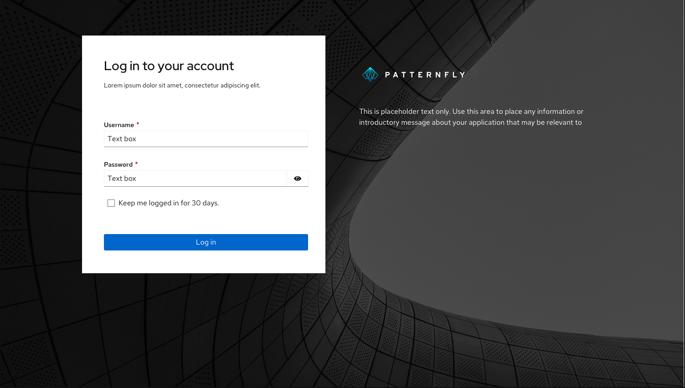
System Design – User Interface
Henry Zektser
Notes:
Next, lets take a look at the UI design. The authentication page is designed to ensure that only authorized users can access the system. This login page relies on an external identity provider (IdP) integration, allowing organizations to leverage their existing single sign-on (SSO) solution for password verification, and optionally two-factor (2FA) authentication.

Slide 8
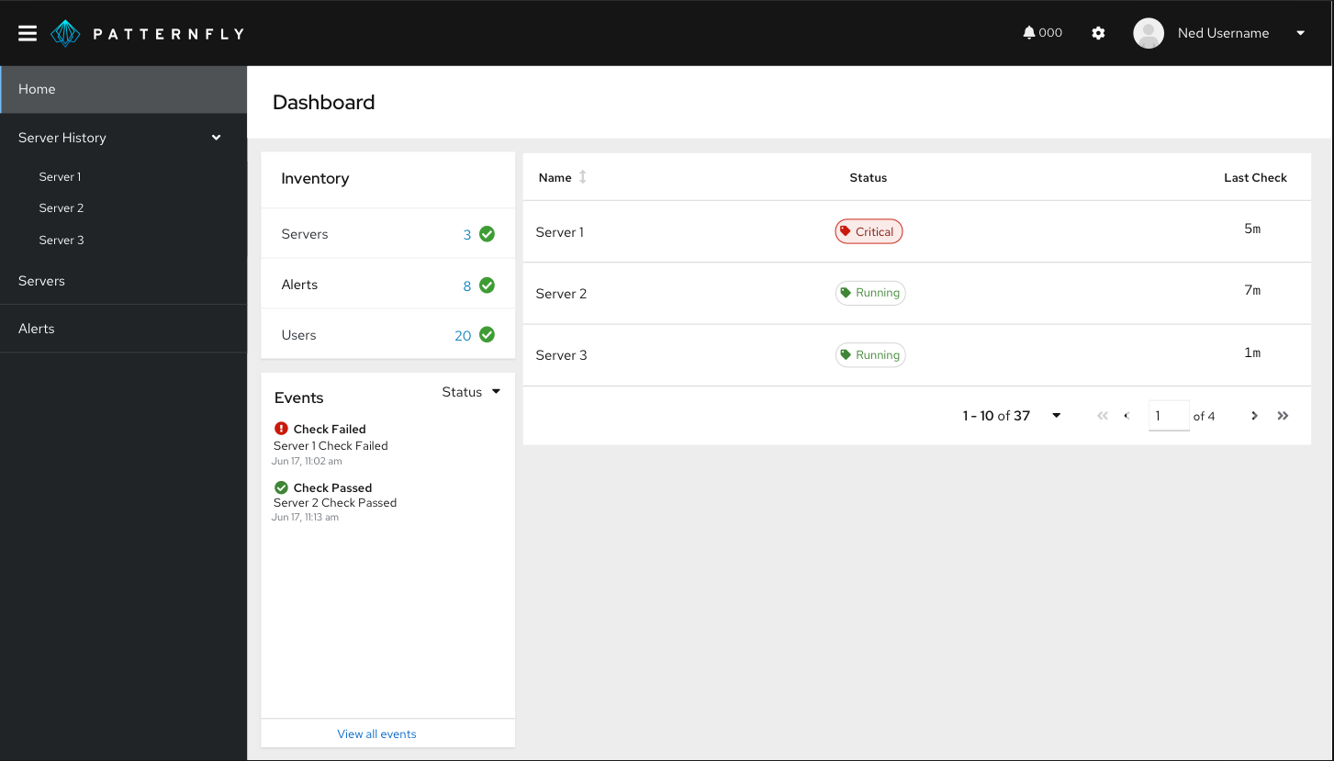
System Design – User Interface
Henry Zektser
Notes:
The status page function is designed to enable the user to see a birds-eye view of all monitored servers within the environment. The page will display all servers, their status (up or down), and the length of time of the last check for that server. This page also displays an inventory (by count) of current Servers, Alerts, and Users registered within the system. Finally, this page displays a summary of recent events within the system, including successful and failed checks within the past hour.

Slide 9
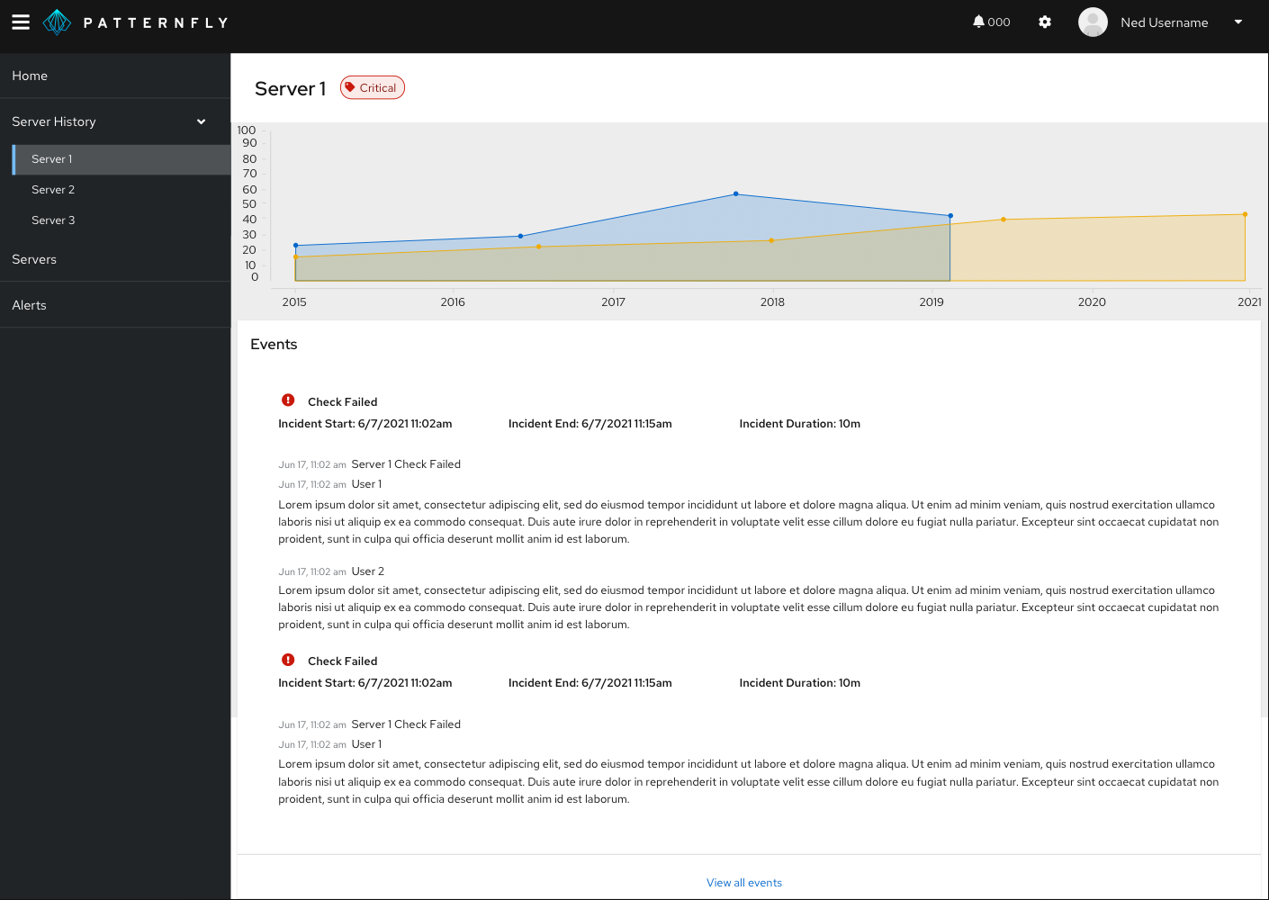
System Design – User Interface
Henry Zektser
Notes:
The server history page is designed to enable the user to see all outage events for a given server for the past 30 days. As per the requirements discussed earlier, this page will show past events along with any associated event notes, providing context for prior issues that may be related to a current outage.

Slide 10
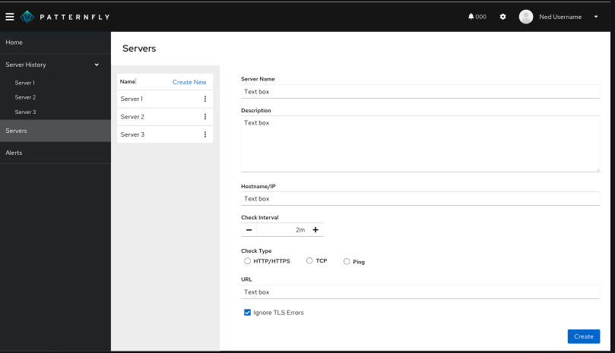
System Design – User Interface
Henry Zektser
Notes:
The server management page is designed to enable administrators to quickly add new servers to the system for monitoring. This page will also enable editing of existing servers already being monitored.

Slide 11
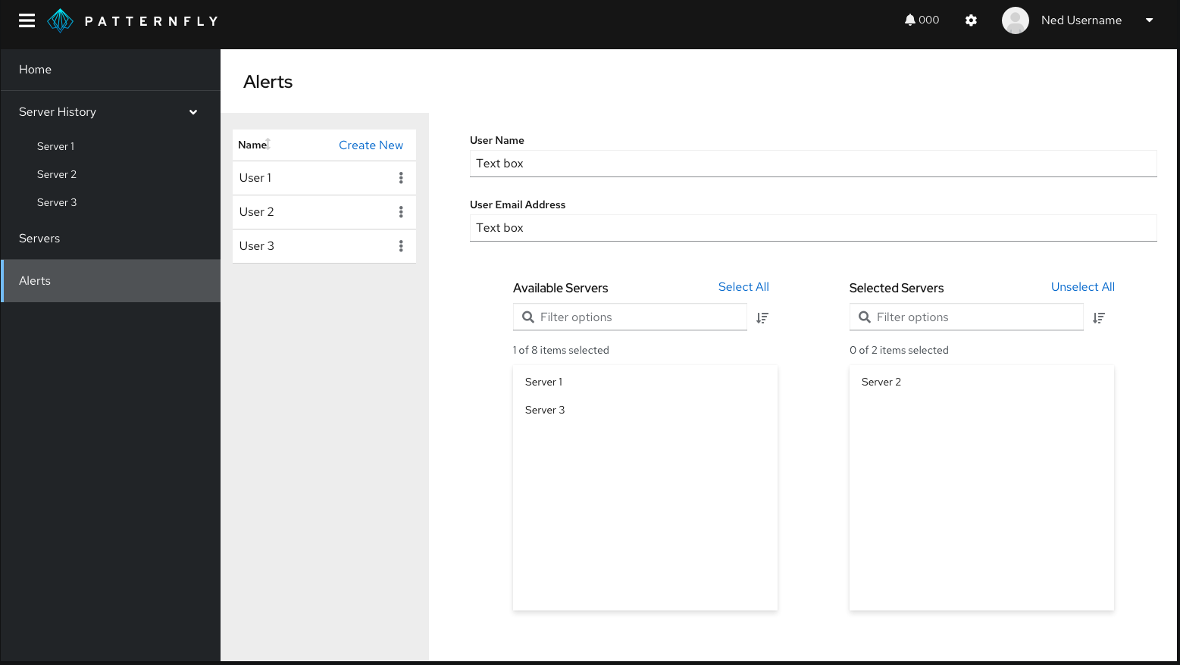
System Design – User Interface
Henry Zektser
Notes:
The alert management page is designed to enable administrators to quickly add new alert recipients to the system for monitoring. This function will also enable editing of existing recipients, as well as removing recipients.

Slide 12
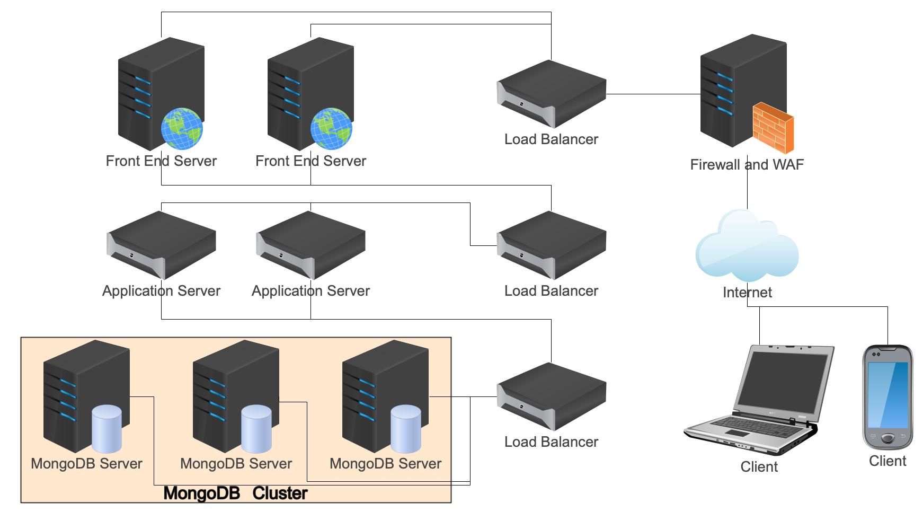
System Design – Infrastructure Architecture
Henry Zektser
Notes:
The proposed technology solution is a robust and highly available system designed to ensure the security, reliability, and scalability of a web-based application. The infrastructure is composed of several key components, including a Firewall/Web Application Firewall (WAF), redundant UI servers, redundant application servers, and a clustered MongoDB database, all supported by load balancers at each layer. This architecture is engineered to meet the demanding requirements of modern web applications and enable both horizontal and vertical scaling of each application tier.

Slide 13
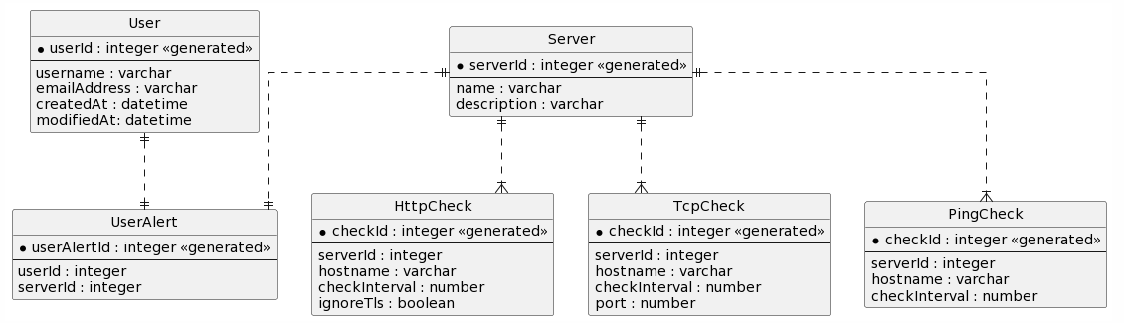
System Design – Information Architecture
Zemenu Guanche
Notes:
The information architecture for this project is simple. Users and Servers are stored as primary entities. A user is bound to servers for alerting purposes via the UserAlert entity. The three supported check types (HTTP, TCP, and Ping) are stored as discrete entities that are keyed to a server. It should be noted that the checks are created with a one-to-many relationship to a server. While not in-scope for this development effort, the schema is set up deliberately to enable a future enhancement wherein a server can be checked in multiple ways. For instance, a ping check to ensure the server is up, and a TCP check to then further ensure an application on that server has not crashed.

Slide 14
System Design – Security Architecture
Confidentiality – Unauthorized Access
Robust ACLs and RBAC
Integrity – Data Tampering
Input and data validation
Availability – Distributed Denial of Service (DDoS)
Load Balancing
Horizontal Scaling
Zemenu Guanche
Notes:
A number of security risks are envisioned in this solution, and compensating controls have been designed to address them .
To mitigate the risk of unauthorized access and protect the confidentiality of sensitive data, the solution will implement robust access control mechanisms. These controls will include user authentication and authorization systems.
To address the risk of data tampering and ensure data integrity, the technology solution will employ data validation and integrity checks at multiple levels. This control involves validating input data on the UI servers, implementing secure data transfer protocols (such as HTTPS) to protect data in transit, and using cryptographic hashing to verify data integrity when it's stored in the MongoDB database.
To safeguard against DDoS attacks and maintain system availability, the technology solution will employ a multi-faceted approach. The Firewall/WAF layer will be configured to detect and mitigate DDoS attacks in real-time. Additionally, the use of load balancers at each layer provides distribution and redirection of traffic to healthy servers, which can help absorb traffic spikes.

Slide 15
References
Team, P. F. (2022). Importance of having a good monitoring system. Pandora FMS Monitoring Blog. https://pandorafms.com/blog/why-you-need-a-monitoring-system/
Digital, Q. (2023). Webinar: How to Build Customer Trust with Outage Communications. Questline Digital. https://www.questline.com/blog/webinar-build-trust-outage-communications/
What is a statuspage and Why do you need it | Freshstatus. (n.d.). https://www.freshworks.com/status-page/why-status-page/
Rubin, C. (2023, April 26). How seamless operations management affects conversions - Blue Stout. Blue Stout. https://bluestout.com/ecommerce/ecommerce-operations-management/
Taylor, S. (2023). Data validation. Corporate Finance Institute. https://corporatefinanceinstitute.com/resources/data-science/data-validation/
Official, A. (2022). How do I mitigate DDoS attacks using AWS WAF? Amazon Web Services, Inc. https://repost.aws/knowledge-center/waf-mitigate-ddos-attacks
Zemenu Guanche
Notes:
Thank you

